Slide 1

Personal Finance Management Project
"Empower Your Finances, Simplify Your Life"
TEAM MEMBERS:
Eliyaz Shaik G.Kowshika P.Sai Santhoshini Yushmanth Divi

Slide 2
Introduction
Modern Financial Management: The Personal Finance Management Project provides a user-friendly solution to manage your finances effectively, offering tools and insights for informed decision-making.
Empowering Financial Decisions: The project aims to empower individuals by offering tools and insights to make informed financial decisions, leading to improved financial health and well-being.
Accessibility and Simplicity: Designed for ease of use, the project is accessible to individuals of all financial literacy levels, providing a seamless and intuitive experience.
Comprehensive Financial Overview: The project offers a holistic view of an individual's finances, consolidating various aspects such as income, expenses, savings, investments, and debts into a single, easily understandable platform.
Goal-Oriented Approach: Users can define and track personalized financial goals, fostering a proactive approach to financial planning and achievement.
PERSONAL FINANCE MANAGEMENT

Slide 3

The Problem
Complexity and Confusion
Lack of Clarity and Control
Managing personal finances can be overwhelming due to multiple accounts, bills, and complex financial products.
Individuals struggle to track expenses, budget effectively, and plan for the future.
PERSONAL FINANCE MANAGEMENT

Slide 4





Key Features
Budgeting & Tracking
Goal Setting
Track income/expenses, create budgets, and receive insightful reports.
Define and track financial goals with personalized recommendations.
Bill Payment
Savings & Investment
Schedule and automate payments to avoid late fees.
Set up savings plans and explore investment options.

Slide 5




Personalized Financial Goal Setting and Monitoring
Set Specific Goals
Define your financial objectives, such as saving for a house or retirement.
Track Progress
Monitor your progress towards your goals and stay motivated.
Get Personalized Insights
Receive tailored recommendations based on your goals and financial situation.
PERSONAL FINANCE MANAGEMENT

Slide 6

Challenges & Solutions
Fragmented Finances
Unified Platform
People often struggle to manage their finances across multiple accounts and services.
The Personal Finance Management Project provides a centralized platform to view and manage all your financial accounts in one place.
Lack of Visibility
Comprehensive Insights
It can be difficult to get a clear picture of your overall financial health and progress towards goals.
The project delivers detailed analytics and reports to help you better understand your finances.

Slide 7
Technology Stack and Architecture
Frontend
Database
Tools & Deployment
HTML5, CSS3, JavaScript.
MYSQL
PyCharm, GitHub.
Backend
Python (Flask).
PERSONAL FINANCE MANAGEMENT

Slide 8



Future Scope
Ecosystem Integration
Advanced Analytics
Financial Community
Integrate with other financial services like insurance, investment platforms, and credit monitoring.
Develop predictive models to provide personalized financial advice and insights.
Create a social platform for users to connect, share financial tips, and learn from each other.
PERSONAL FINANCE MANAGEMENT

Slide 9
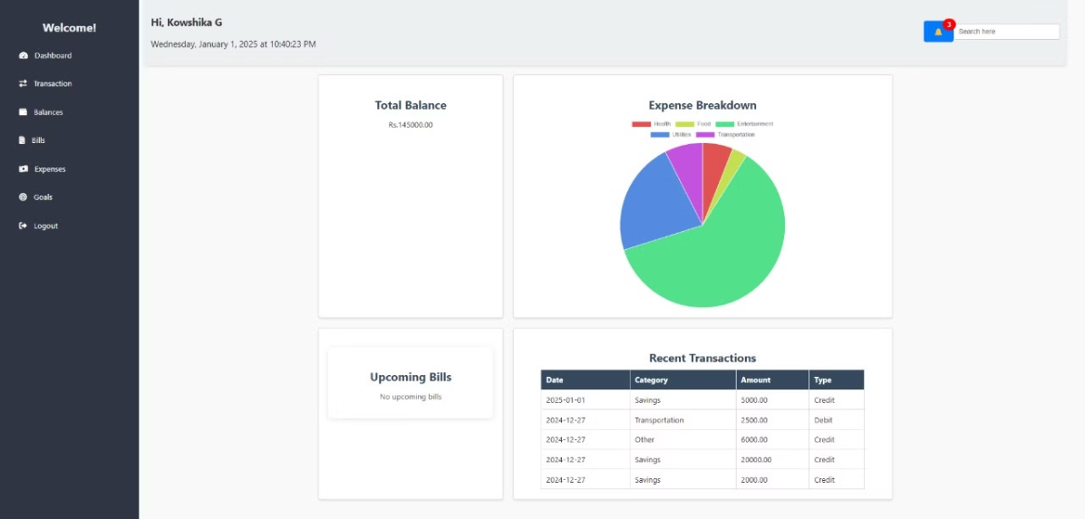
output:
FIRST PAGE IMAGE OF PROJECT INTERFACE .
PERSONAL FINANCE MANAGEMENT

Slide 10
THANK YOU
PERSONAL FINANCE MANAGEMENT

